Slide 1
Lecture #2 Introduction to Object Oriented Programming (Contd...)
Roshan Manjushree Adhikari
Computer Science
2nd of May, 2018

Slide 2
Previously..........
Software evolution
Machine -> Assembly -> Procedure -> Object-Oriented
Motivation behind OOP
What is OOP?
What is object?
Quick work for you

Slide 3
What today?
Basic concepts of OOP
Objects
Classes
Data abstraction and encapsulation
Inheritance
Polymorphism
Dynamic binding
Message passing
Benefits of OOP

Slide 4

Basic concepts of OOP
Objects
Classes
Data abstraction and encapsulation
Inheritance
Polymorphism
Dynamic binding
Message Passing

Slide 5
Remember this ????
action
data
object wraps data + action

Slide 6
In the simplest language possible..........
An object oriented program is nothing but, some objects just passing messages to each other that keep the program running.
POP = Data1 + Data2 + ............+ Action1 + Action2 + Action3 + .............
OOP = ObjectA + ObjectB + ObjectC + ObjectD + .................

Slide 7
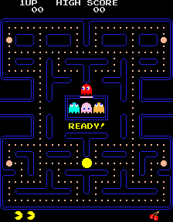
“Pacman” from OOP view point

Slide 8


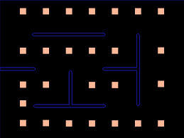
What could be the objects in Pacman?

Slide 9
Object: Ghost1
Data: color
name
state
direction
speed
Action:
move()
changeState()

Slide 10
Classes
Class is a blueprint for a object. It is a structure of data and actions.
Objects are variables of the type class.
Object cannot exist without a class.
Multiple objects can be created from one class.
Objects are independent of each other. But can talk to each other.

Slide 11

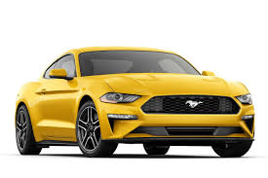
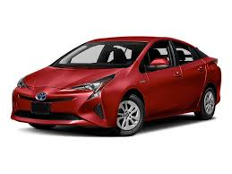
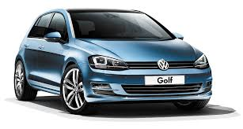
Car class
color
manufacturer
brand
energy
Yellow
Ford
Mustang
Gasoline
Red
Toyota
Prius
Electricity
Blue
Volkswagen
Golf
Diesel

Slide 12

Human class
Data:
name, age, weight, height, address
Action:
eat()
walk()
sleep()
excercise()
run()
talk()

Slide 13



Human class
Objects of ‘Human’ class

Slide 14
name = Mark Zuckerberg
age = 33 years
weight = 154 pounds
height = 1.71 meters
address = Palo Alto
object of class “Human”

Slide 15
Inheritance
Inheritance enables new classes to inherit the properties and methods of existing classes.
It is a process by which objects of one class acquire the properties of objects on another class. Can be described as IS-A relationship.
Inheritance provides reusability.
For example: animal class is divide into mammals, insects, birds and so on.
For example: class Vehicle is divided into cars, truck, bus, motorcycle etc.

Slide 16
Base class
Feature A
Feature B
Feature A
Feature A
Feature A
Feature B
Feature B
Feature B
Feature C
Feature D
Feature F
Feature E
Derived classes

Slide 17
Using Inheritance in an game
Enemy
Soldier
Monster
Dragon
Soldier can walk.
Soldier shot arrows at you.
Monster jump
Monster shoot gun at you.
Dragons can fly
Dragons breath fire
Notes:
Tea and Coffee
IS-A relationship.
Accounts
Pizza

Slide 18
Quick Work for you
For any software application you can imagine, write down a class. Write down some derived classes of that class.
JUST REMEMBER, “IS-A” relationship.

Slide 19
Data abstraction and encapsulation
The wrapping of data and functions into a single unit (called class) is known as encapsulation.
Data is not accessible to outside world, only functions wrapped in the class can access it.
The insulation of data from direct access by the program is called data hiding or information hiding.
Abstraction is representing features without including background details or explanations.
Classes are known as Abstract Data Types (ADTs).

Slide 20
Polymorphism
Poly + morphism
Polymorphism is the ability of an object to take on many forms.

Slide 21
Shape
Draw()
Circle object
Draw(circle)
Box object
Draw(box)
Triangle object
Draw(traingle)
Fig: Polymorphism

Slide 22
Message passing
Programming an OO code involves:
creating classes that define objects and their behavior
creating objects from class definitions
establishing communication among objects
A message for an object is a request for execution of a procedure, and therefore will invoke a function in receiving object.
The concept of message passing makes it easier to build systems that model or simulate real-world problems.

Slide 23


Slide 24
Benefits of OOP
Concept of objects help programmers to organize softwares as collection of objects rather than dozens of confusing modules and linking mechanism.
Through inheritance, we can eliminate redundant code and extend the use of existing classes which is not possible in procedure oriented approach.
We can build programs from the standard working modules that communicate with one another, rather than having to start writing the code from scratch which happens procedure oriented approach. This leads to saving of development time and higher productivity.
The principle of data hiding helps the programmer to build secure programs that cannot be invaded by code in other parts of the program.
It is possible to have multiple instances of object to co-exist without any interference.
Notes:
What programmers think ?

Slide 25
Benefits of OOP (contd...)
It is possible to map objects in the problem domain to those in the program.
It is easy to partition the work in a project based on objects .
Object oriented systems can be easily upgraded from small to large systems.
Message passing techniques for communication between objects makes the interface descriptions with external systems much simpler.
Software complexity can be easily managed.

Slide 26
Assignment #1: Related to C Programming Language
What do you mean by function? Illustrate the difference between pass by value and pass by reference.
Define Structure. How does it differ with Union? Illustrate with an example.
What is the difference between array and pointer variable? In what way are they similar?
Deadline: 9th May, 2018

Slide 27
In next class...........
Introducing C++
A sample C++ program
Reference variables
Inline functions

